Slide 1
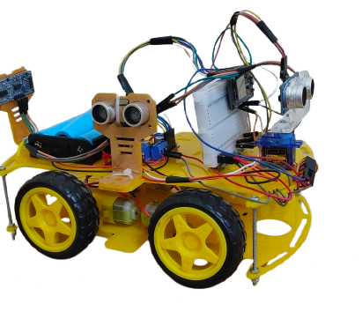
Embedded System Project
Obstacle avoidance AND autonomous parking Car

Slide 2


Agenda
- Schematic
- MQTT
- Flutter Application
Components

Slide 3

Schematic
The System Structure

Slide 4
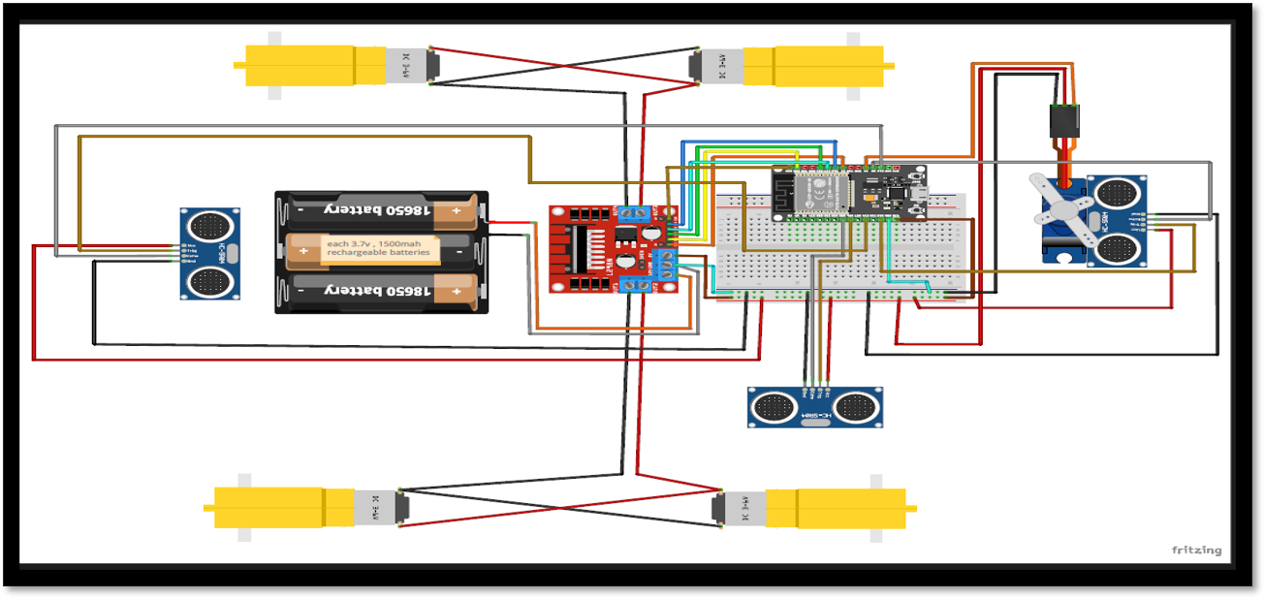
Schematic

Slide 5

Components

Slide 6
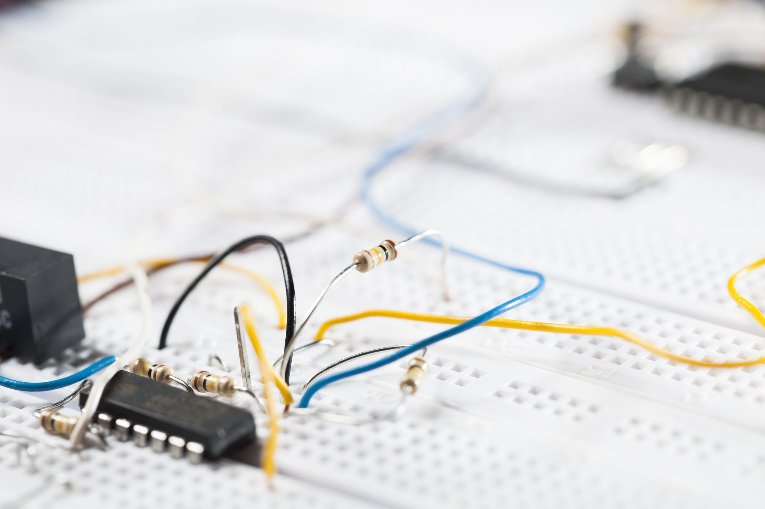
Components
Microcontroller: ESP32 – High-performance, dual-core MCU with integrated Wi-Fi and Bluetooth, ideal for IoT applications.
Sensors: 3 × Ultrasonic Sensors – Used for distance measurement and obstacle detection, enabling autonomous navigation.
Actuators:
1 × Servo Motor – Provides precise angular movement for mechanisms such as steering or sensor positioning.
4 × DC Motors – Drive the main motion of the system, offering speed and direction control.
Power Supply: 3 × 18650 Lithium-ion Batteries (1500 mAh each) – Rechargeable and connected in an appropriate configuration to power the system reliably.
Motor Driver (H-Bridge): L298N Dual H-Bridge – Enables control of motor direction and speed for DC

Slide 7
MQtt Server
Communication

Slide 8

MQTT Server
Wi-Fi and MQTT Integration: ESP32 also connects to a Wi-Fi network and communicates with an MQTT broker. It publishes Flutter button modes and ESP 32 can subscribe on it and control actions to specific MQTT topics and receives control commands via MQTT.

Slide 9

Flutter mobile
Application

Slide 10
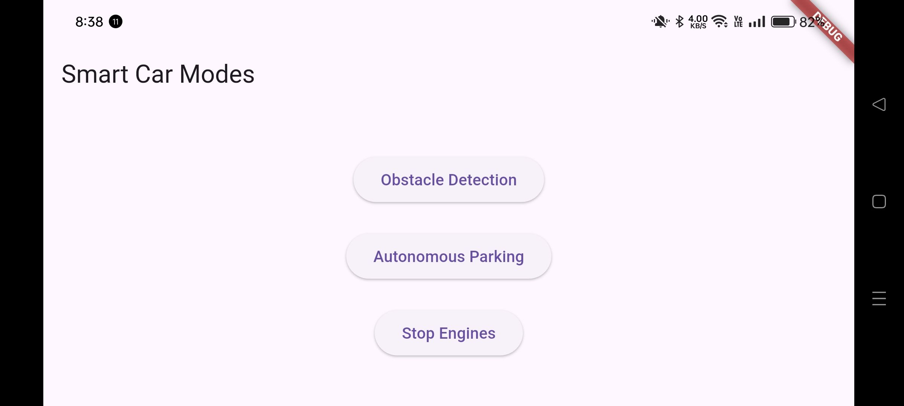
Flutter mobile Application
It consists of 3 buttons :-
1- obstacle detection
2- Autonomous Parking
3- Stop Engines

Slide 11

Thanks
أحمد إيهاب عبد الحليم عبده عجمى 2203163
احمد مراد عبد الحميد محمد قاسم2203187
مروان طارق امبابى رزق إبراهيم22011615
يوسف محمد حلمى أحمد2203163
أدهم معتز محمد عبدالمنعم22010467

